Slide 1

MY BROTHER RABBIT
MARKETING PLAN

Slide 2
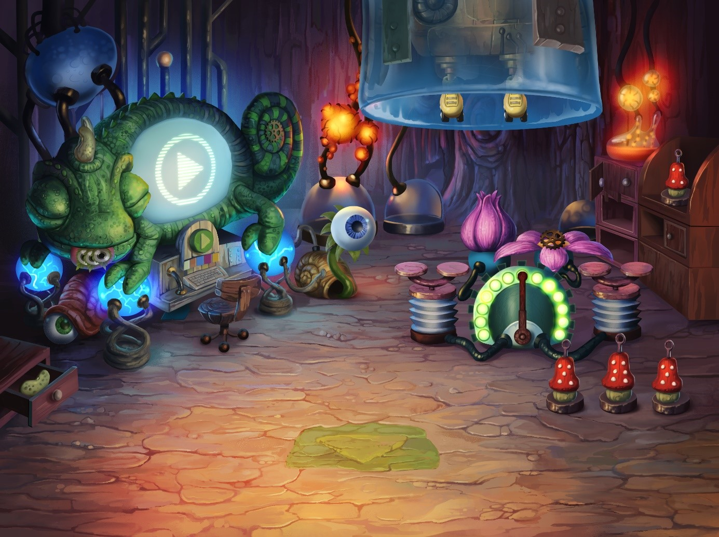
GAME OVERVIEW
Title:
MY BROTHER RABBIT
Description:
AN UPLIFTING POINT & CLICK ADVENTURE GAME SET IN THE SURREAL WORLD OF CHILDREN’S IMAGINATION.
Notes:
[Sz.]Krótko o czym jest gra

Slide 3
REALISTIC SETTING
TOYMAKER
PILLARS OF EARTH
THIMBLEWEED
PARK
ENIGMATIS
EXPLORATION & HO GAME
ADVENTURE
MY BROTHER RABBIT
SILENCE
THE TINY BANG STORY
MACHINARIUM
SAMOROST 3
SURREAL/FANTASY SETTING

Slide 4
SWOT
POSTITIVE FACTORS
NEGATIVE FACTORS
STRENGTHS
GRAPHICS [SURREAL WORLD]
MUSIC AND SOUND
WILL AGE WELL
WEAKNESSES
„ONE MECHANIC” GAME
PASSIVE CHARACTERS
NON STORY-HEAVY
INTERNATL FACTORS
OPPORTUNITIES
MAY APPEAL TO AUDIENCE OF INDIE GAMES (AMANITA DESIGN)
THE DISTINCTIVE VISUALS WILL MAKE IT MORE LIKELY TO BE FEATURED ON MOBILE STORES (APPLE, GOOGLE)
THERE’S A GROWING DEMAND FOR THAT KIND OF GAMES ON CONSOLES
THREATS
MIGHT GET BORING TOO SOON WHICH WILL RESULT IN REFUNDS ON STEAM
LACK OF CLEARLY DEFINED DIRECTION (SOMETHING BETWEEN HOPA AND CLASSIC ADVENTURE)
MIGHT BE PERCEIVED AS A GAME FOR CHILDREN
EXTERNAL FACTORS

Slide 5
THE COSEQUENCES FOR THE MARKETING CAMPAIGN
POSTITIVE FACTORS
NEGATIVE FACTORS
STRENGTHS
GRAPHICS WILL BE STRONGLY FEATURED
OST BY AREK REIKOWSKI
MBR WILL GET REGULAR UPDATES AND PERHAPS A POST LAUNCH DEMO
WEAKNESSES
WE DON’T FOCUS ON AVERAGE QUALITY FEATURES
WE SHOW THE BEST MBR HAS TO OFFER (VISUALS AND MUSIC)
INTERNATL FACTORS
OPPORTUNITIES
MARKETING PERSONA
WILL TRY TO BE FEATURED (PAPERWORK)
COOPERATION WITH PARTNERS AND AS MANY BUNDLES ON CONSOLES AS POSSIBLE
THREATS
WILL TRY TO GET COVERAGE IN THE MORE „FRIENDLY” PRESS AND MEDIA FIRST
WE WILL UNDERSCORE THE DARKER UNDERTONES OF THE GAME
EXTERNAL FACTORS

Slide 6
MARKETING PERSONA vs. MARKETING CAMPAIGN
Agnes Jones
Woman, 30, USA
CHARACTERISCTICS | CONSUMER BEHAVIOUR | CONSEQUENCES FOR THE CAMPAIGN
MOTHER | SHE HAS LIMITED TIME, WELL ORGANIZED, PREFERS RELAXING AND NON VIOLENT GAMES | WE DON’T WANT TO SHOCK HER WITH CONTENT OR THE WAY THE MARKETING CAMPAING IS DELIVERED
A SELF-AWARE CONSUMER | SHE KNOWS WHERE TO LOOK FOR INFO ON GOOD GAMES (ROCKPAPERSHOTGUN, POLYGON) | WE KNOW WHO TO APPROACH
GOOD TASTE | SHE LOOKS FOR SOMETHING UNUSUAL AND UNIQUE IN GAMES (VISUALS, MUSIC, STORY) | WILL STRONGLY FEATURE THE GRAPHICS AND MUSIC IN OUR CAMPAIGN
LIKES EASTER EGGS, 90’S NOSTALGIA, UNUSUAL HISTORIES AND SETTINGS IN GAMES | SHE PLAYS INDIE TITLES - CHUCHEL, MACHINARIUM, NIGHT IN THE WOODS, OXENFREE | GOLDMINE OF CONTENT IDEAS AND REFERRALS
WATCHES NETFLIX AND HBO | ATYPICAL, SENSE8, JESSICA JONES, 13 REASONS WHY, GILMORE GIRLS, STRANGER THINGS | WILL HELP US TO TARGET ADS
ACTIVE ON SOCIAL MEDIA - FB, YT, TWITTER, INSTAGRAM | FB (FRIENDS AND FAMILY), YT AND INSTAGRAM (RECOMMENDATIONS BY INFLUENCERS) | WE KNOW WHAT TYPE OF CONTENT TO POST AND WHAT INFLUENCERS TO APPROACH
FINANCIALLY INDEPENDENT | SHE CAN AFFORD TO BUY A GAME BUT ALSO APPRECIATES HIGH VALUE PRODUCTIONS | WILL PAY 20 DOLLARS FOR A GAME
GEEK | ENJOYS VARIOUS GADGETS (LOOTBOXES) AND EVENTS LIKE COMIC CON AND PAX | PAX IS A PLACE TO BE (ALSO WE WILL HAVE A PLUSH TOY OF A RABBIT)

Slide 7
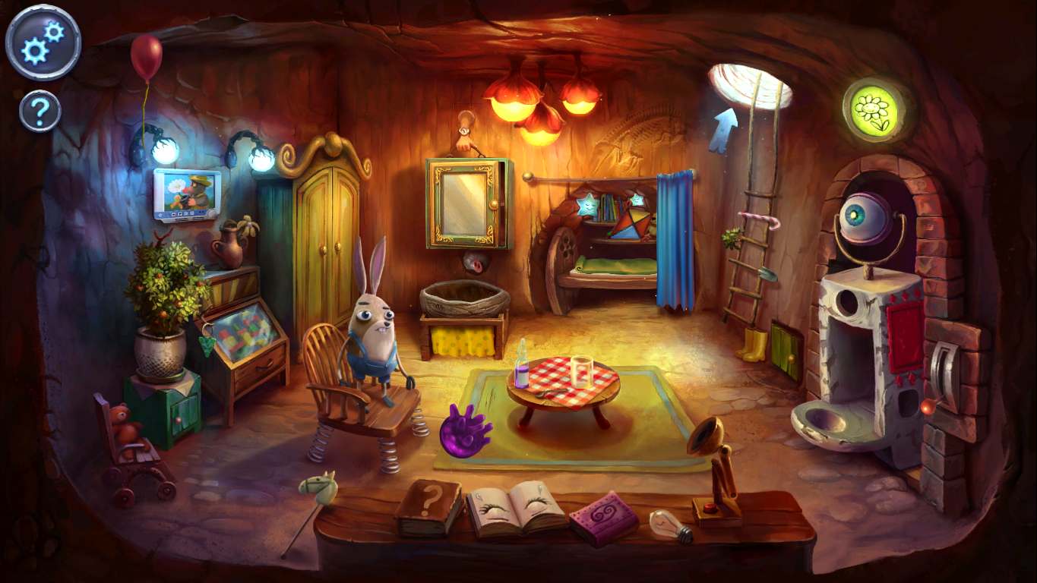
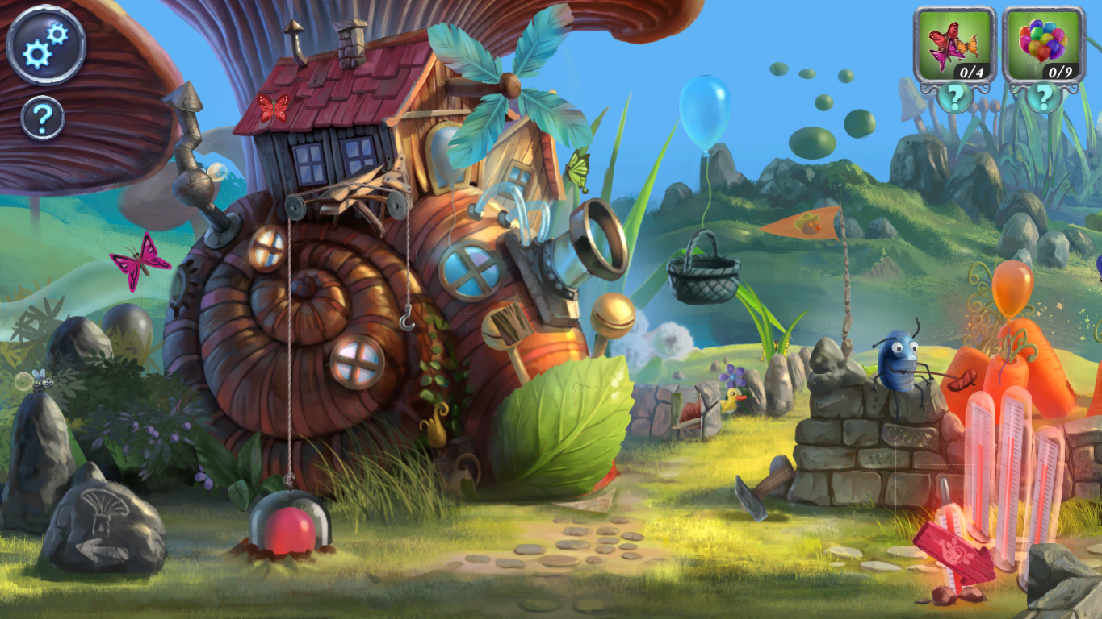
BIG IDEA
”IMAGINATION WILL FIND A WAY”
The main theme of the marketing campaign is the power of imagination that allows the protagonitsts to find a way out of a difficult situation.
Notes:
.

Slide 8
3 PILLARS OF MARKETING CAMPAIGN
Big IDEA
IMAGINATION WILL FIND THE WAY
I. World
surreal
graphics
III. Puzzle
weird puzzles
II. Audio
music and
sounds

Slide 9
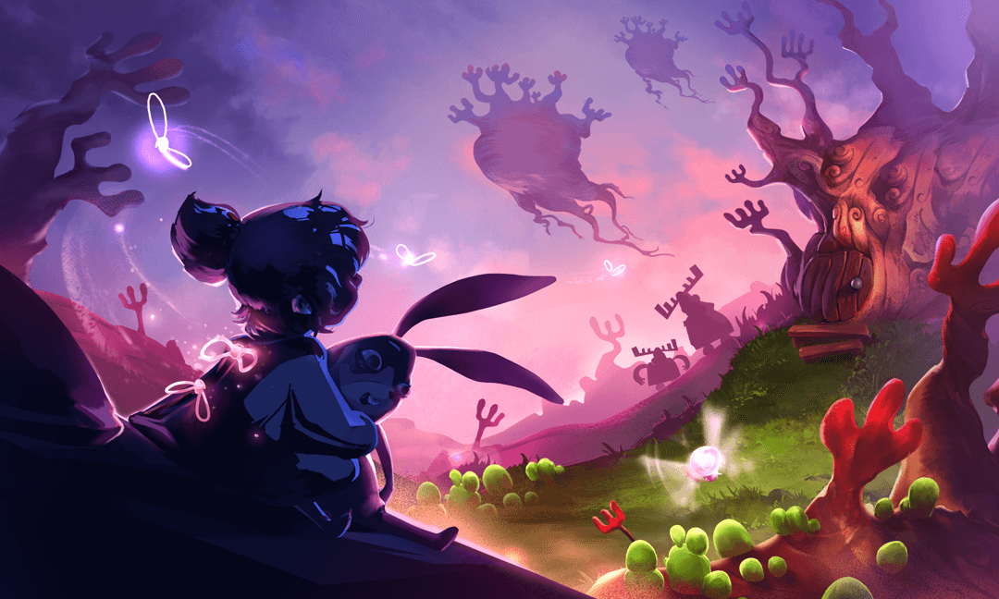
KEY ART

Slide 10
CAMPAIGN TOOLS
Press
Influencers
Partners
Social Media
Events

Slide 11









PRESS

Slide 12








INFLUENCERS
NON-VIOLENT GAMING
GEEK
POP-CULTURE

Slide 13









PARTNERS

Slide 14


EVENTS
GAMESCOM
21 - 25 August 2018
Indie Games Polska Foundation
Crew: TEAM PR and MBR TEAM
PAX WEST
31 August – 2 September 2018
Indie Games Polska Foundation
Crew: TEAM PR and MBR TEAM

Slide 15




SOCIAL MEDIA
THE WORLD | AUDIO | PUZZLE
„The World in different colors” – Instagram filters „Imagination as medicine for fears and anxieties” (dark silhouettes that become benevolent creatures when the light is on) GIF The reverse of a natural/common order of things (the horses fly, the clocks go backwards) VIDEO | The music by Arek Reikowski with some game video SOUNDTRACK „Timelapse of artwork drawing enriched by the music from the game” VIDEO | Imaginary language („listwish” instead of „wishlist”) and encouraging fans to solve puzzles COMMUNITY/CONTEST „Puzzles that require a change of persperctive” CONTEST/GRAPHICS

Slide 16

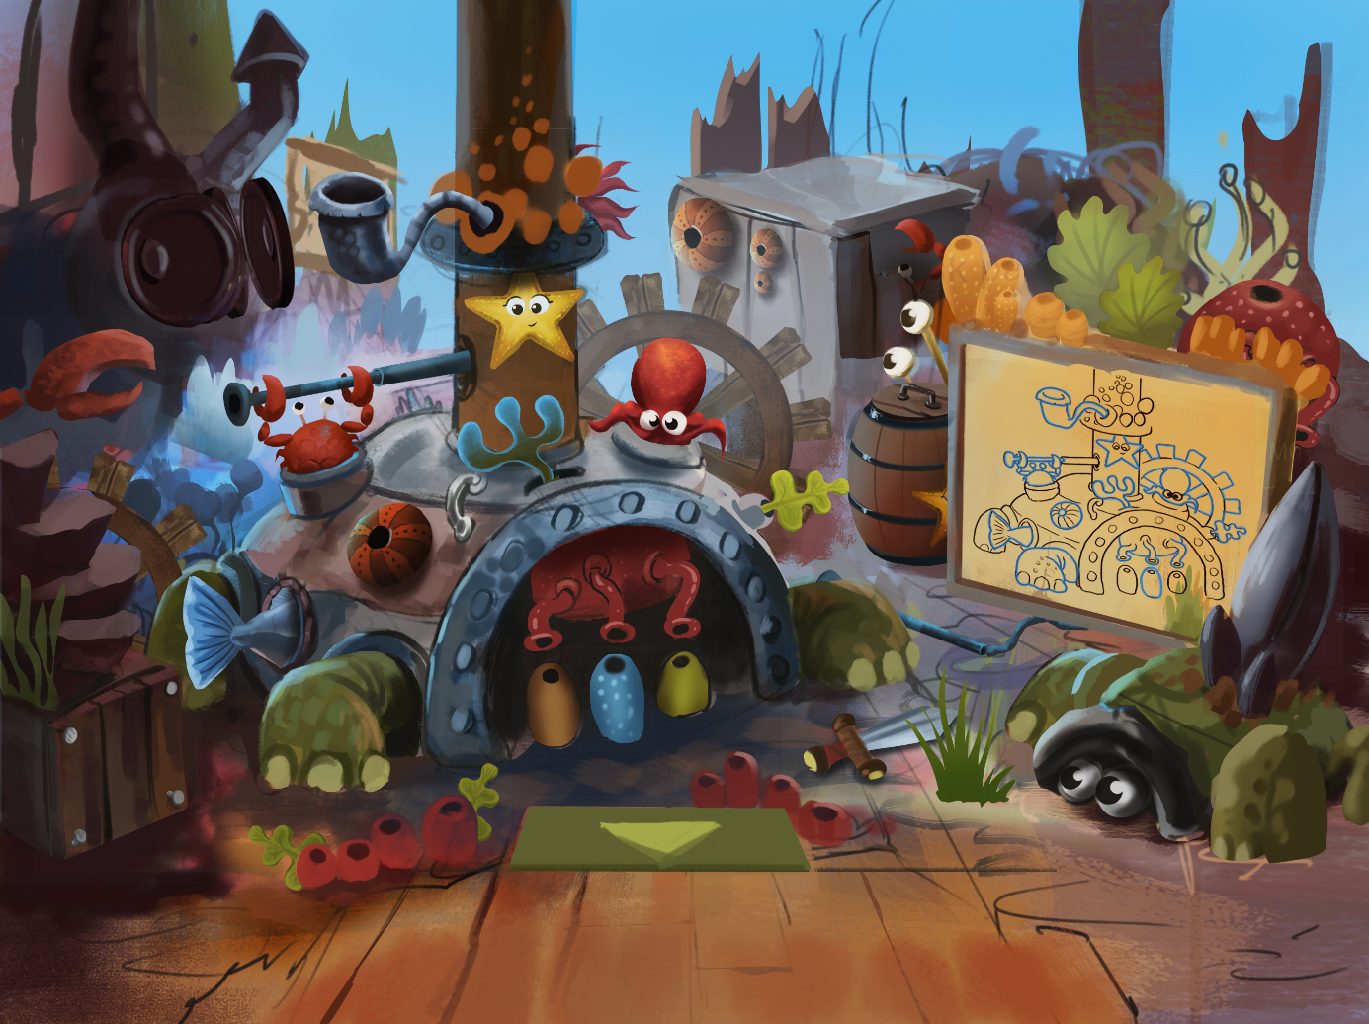
HOPA CAMPAIGN FOR MOBILE/STEAM (Later on)
HOPA PRESS
NEWSLETTER
PUSH
BUNDLE WITH OTHER AM HOPA GAMES
CONTACT WITH PRESS AND YOUTUBERS
CONTESTS FOR STEAM GROUPS
GOOGLE AND APPLE FEATURES
HOPA CONTENT IN SOCIAL MEDIA

Slide 17
APRIL
JUNE
MAY
JULY
AUGUST
SEPTEMBER
OCTOBER
NOVEMBER
DECEMBER
COMING SOON
LAUNCH PC/CONS
LAUNCH MOBILE
PREPARATIONS
WORLD
AUDIO
PUZZLE
MOBILE & SWITCH
GAME SUPPORT
Teaser Trailer
FB, Instagram ads
Social Media
WWW – launch
Steam Game Page
Press release
Newsletter
Story Trailer
FB, Instagram ads
Social Media
Steam GamePage
Media alert
Newsletter
Launch Trailer
Review keys for media
Social Media
FB, Instagram ads
Steam GamePage
Newsletter
Gamescom and PAX
Trailer (Mob + NS)
Media alert
Google and Apple paperwork
FB, Instagram ads
Steam Game Page
Newsletter

Slide 18











PLATFORMS AND PRICE
Price: $19.99 (most likely)
At least 2 editions (soundtrack + themes)
Dedicated Avatars on Xbox One
Launch discount 10-20% (most likely)
Bundles with Artifex Mundi HOPA titles

